Slide 1
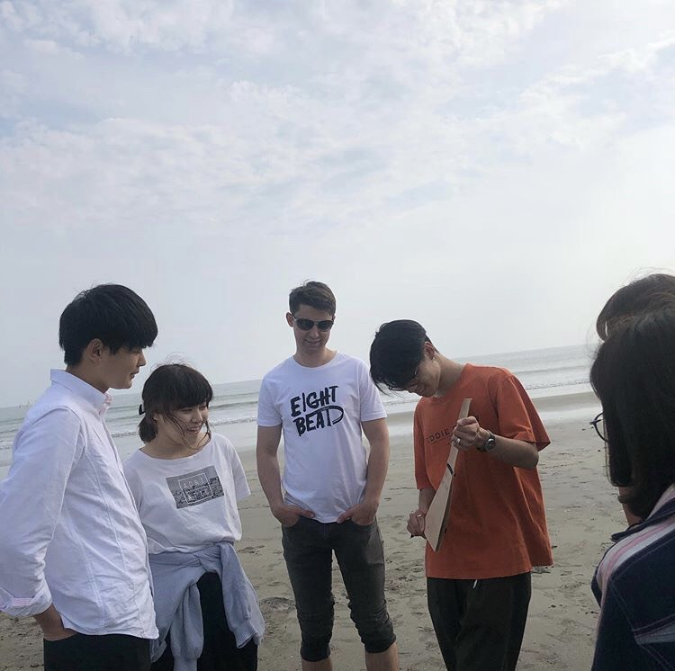
Our Non Plastic Revolution
-Protecting the Ocean Animals-
School of International Liberal Studies
Kamakura
Introduction
Question or Methods
Results
Conclusions
Video:
[See how it feels like to be an ocean animal stuck in a plastic bag]
Over one million marine creatures, and other birds and animals die each year from plastic trash.
There are 5.25 trillion pieces of plastic debris in the ocean.
Target:
Ocean animals
Local community
Government
Place and Occasion:
Kamakura and Yuigahama Beach
Test Interview at Waseda University:
We interviewed 8 people in total, 7 Japanese people and 1 foreign student.
1.
23 people for 8,000,000 ton/year
2 for 8,000 ton/year
2.
1 for 100,00
24 for 1,000,000
3.
13 for eco bags
12 for biodegradable bags
4.
Use tumblers instead of using plastic bottles.
Drink all of the ramen soup.
Refuse getting plastic bags.
5.
Encourage government to invest in biodegradable research.
Restrict the use of plastic bags legally.
Know the importance of each life.
Through the Kamakuma Field trip and the interview we conducted, we found that majority of people notices the problems and willing to act toward them but generally do not have enough awareness and knowledge toward the concerning issues. This could lead to a no end result that nothing could be really done doe the ocean animals.
Do you know how much plastic garbage is being thrown out to the ocean every year?
How much sea creatures die from plastic garbage every year?
Which do you think is better to protect these marine creatures?
What do you do to protect marine animals?
What would you like to do in the future?
Suggestion
In order to solve the problem, we suggest that the local government could make and strength more policies regarding to plastics used. And by providing citizen chances for participating through volunteer activities and education for the future generation and of course every individuals, people can gradually gain knowledge and awareness with more efficient actions followed.
Order online at https://www.postersession.com/order/

